Slide 1
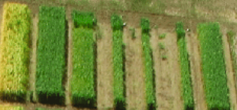
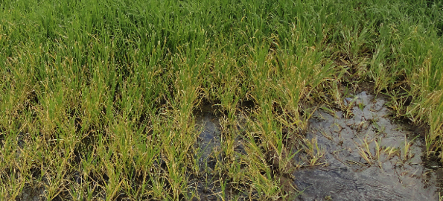
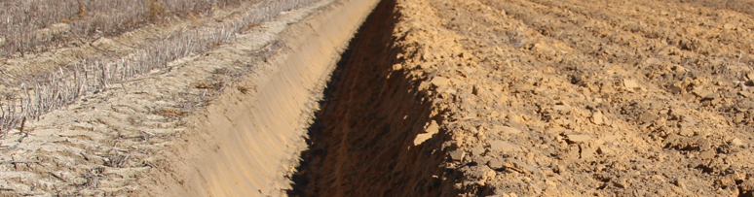
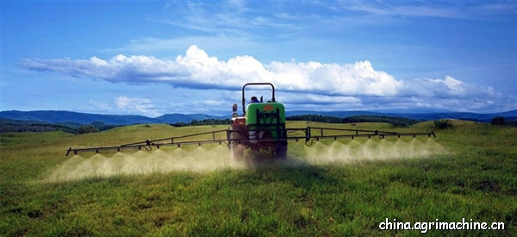
What is important for yield improvement
(G x E x M)
Genotype (G) ?
Environment (E) ?
Management (M) ?

Slide 2
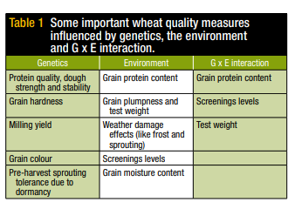
Experimental studies with several E and containing both G and M (all WA)
Authors % of variance attributed to:-
G M E Interactions
Anderson et al. (2005) 3 2 26 60
Sharma et al. (2008) - 10 70 7
D. Hughes (pc, 2010) 2 6 89 -
Anderson et al. (2010) 2 4 78 15
Abrecht et al. (2008)Mer - 36 42 17
Koj - 56 16 22

Slide 3
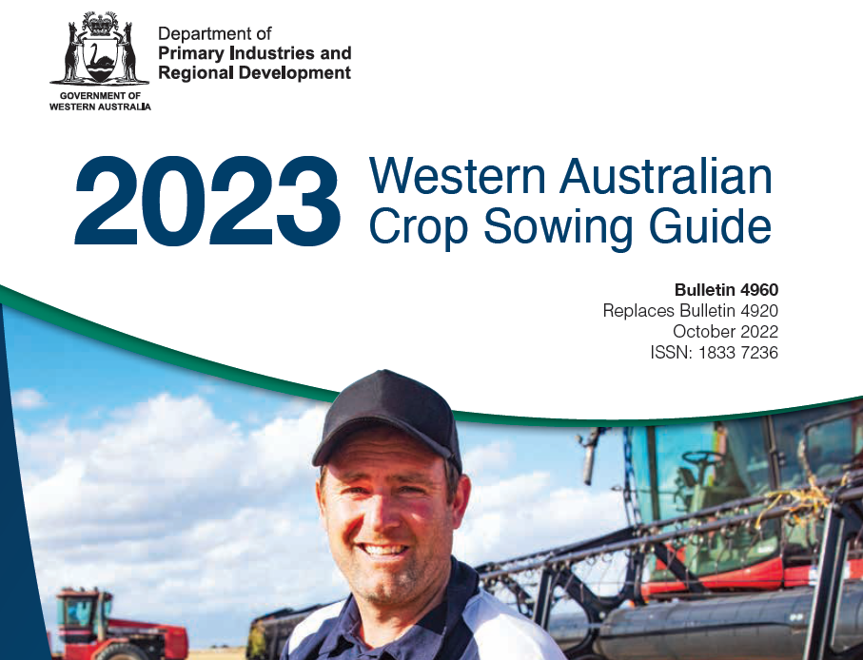
Spike/Spikelet – wheat

Slide 4
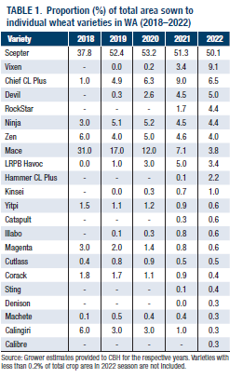
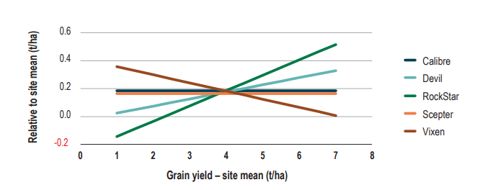
Wheat
Notes:
2n = 14 i.e. 7 pairs. Polyploid cells and organisms are those containing more than two paired sets of chromosomes. Most species whose cells have nuclei are diploid, meaning they have two sets of chromosomes—one set inherited from each parent. Tetraploids (Durum) have two sets of paired (or 4 sets) chromosomes. Hexaploids have three sets of paired chromosomes (six sets), three times as many as in diploid wheat

Slide 5
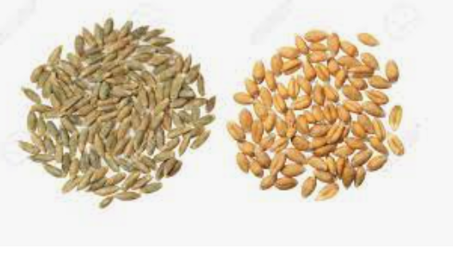
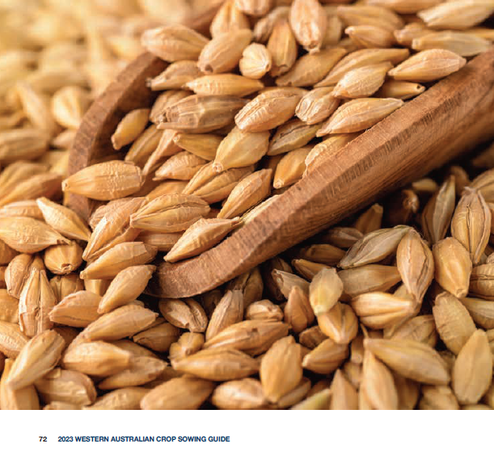
Grain classification – wheat/barley

Slide 6
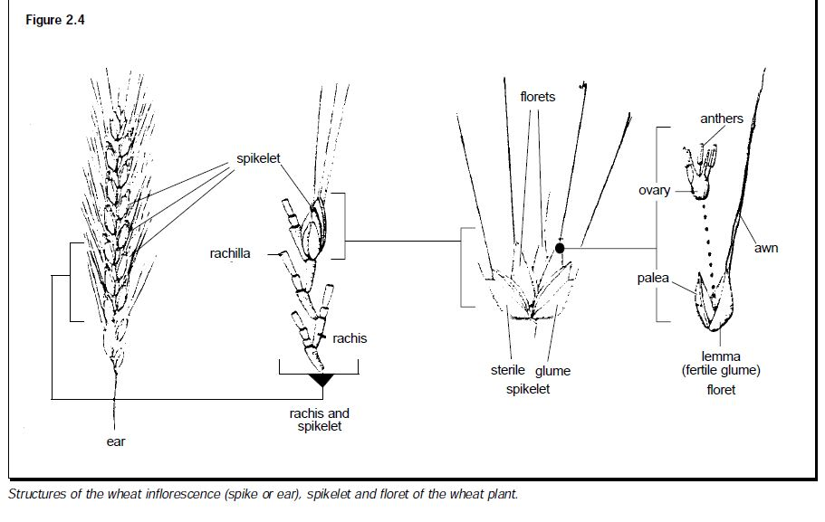
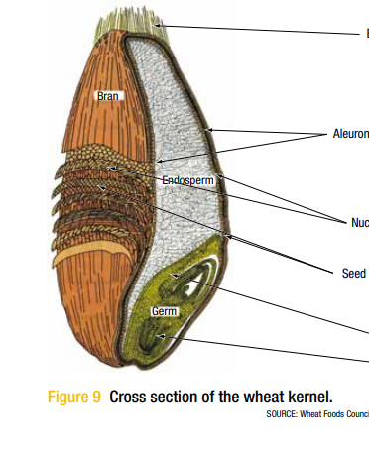
Spike/Spikelet – wheat
1 – 5 florets/spikelet
18-22 spikelets/head
30-50 grains/head
Endosperm (8-16% protein) -> flour
Soft wheat: a soft, opaque and less compact endosperm compared to hard wheat. Good for biscuits.
Hard wheat: wheat which has a vitreous endosperm. Good for bread.

Slide 7
Taxonomy – wheat
Both wheat and barley belong to the family Poaceae and tribe Triticeae,
Common wheat bread wheat (Triticum aestivum)
(9-12% protein).
Durum wheat (pasta and macaroni)
(T. turgidum ssp durum)
  Durum is high in protein (13-14%), low in gluten, and tends to be quite dense. As compared to other wheat varieties it tends to be very heavy, which can make it difficult for people to use it in breads that need a lighter, airier quality; it is often prized in the flatbreads.
They are annuals, self pollinating

Slide 8
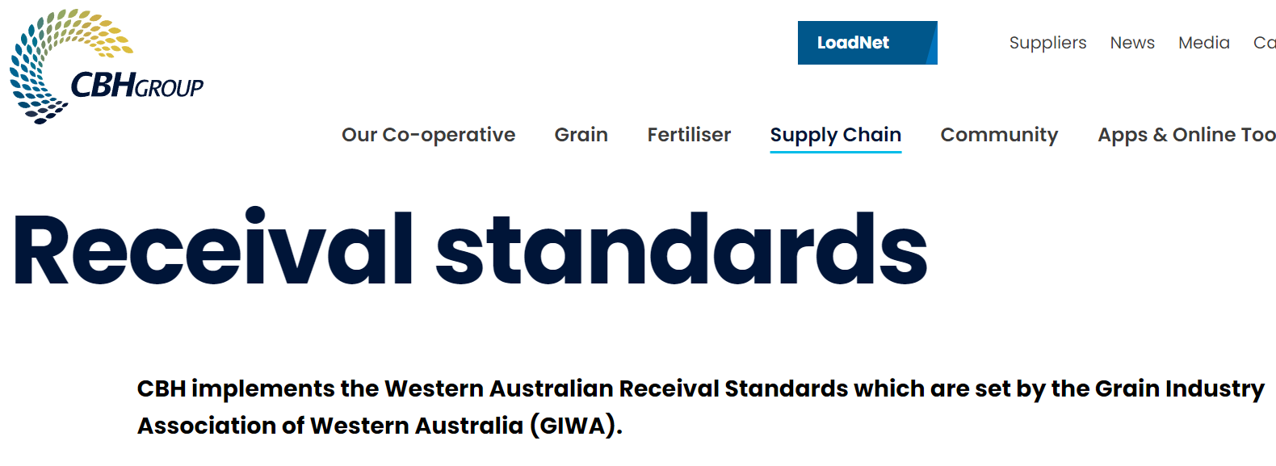
Wheat classification
Notes:
2n = 14 i.e. 7 pairs. Polyploid cells and organisms are those containing more than two paired sets of chromosomes. Most species whose cells have nuclei are diploid, meaning they have two sets of chromosomes—one set inherited from each parent. Tetraploids (Durum) have two sets of paired (or 4 sets) chromosomes. Hexaploids have three sets of paired chromosomes (six sets), three times as many as in diploid wheat

Slide 9
Wheat classification
Premium Hard Wheats
  Australian Premium Hard (APH) – high protein – High volume European-type breads, ramen noodles etc.
  Australian Hard (AH) mid-high protein – European pan, Middle Eastern style flat breads, steamed products
  Australian Premium White (APW) – noodles some continential flat breads
Multi-Purpose Wheats
  Australian Standard White (ASW) – Med-low protein – straight milling or blending. European-style breads and rolls
Notes:
2n = 14 i.e. 7 pairs. Polyploid cells and organisms are those containing more than two paired sets of chromosomes. Most species whose cells have nuclei are diploid, meaning they have two sets of chromosomes—one set inherited from each parent. Tetraploids (Durum) have two sets of paired (or 4 sets) chromasomes. Hexaploids have three sets of paired chromosomes (six sets), three times as many as in diploid wheat

Slide 10
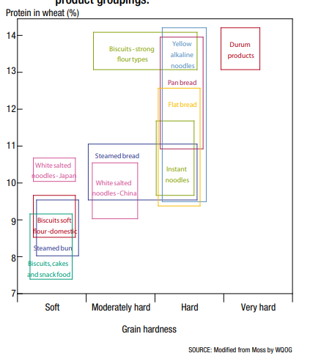
Wheat classification
Specialty Wheats
  Australian Premium Durum (ADR) – Pasta, couscous, flat breads
  Australian Noodle (ANW) – Japanese Udon-style noodle.
  Australian Premium Noodle (APWN) – WA only/Export – white salted/instant noodles.
  Australian Soft (ASFT) – produced on east coast biscuit making etc.
Notes:
2n = 14 i.e. 7 pairs. Polyploid cells and organisms are those containing more than two paired sets of chromosomes. Most species whose cells have nuclei are diploid, meaning they have two sets of chromosomes—one set inherited from each parent. Tetraploids (Durum) have two sets of paired (or 4 sets) chromasomes. Hexaploids have three sets of paired chromosomes (six sets), three times as many as in diploid wheat

Slide 11
Wheat classification
Australian Durum (DR) min 11.5 - 13%
Australian Hard (APH1/2, AH1/2): min 11.5 - 14% protein. $370
Australian Premium White (APW1/2): min 10 – 10.5% protein. $365
Australian Standard White (ASW1/2) no min. $340
Australian Standard White (ASW): no min protein
Australian Noodle Wheat (ANW1/2): no min - min 9.5%, max 11.5%
Australian Soft: No min – max 9.5 – 10.5 % protein.
Feed wheat – No protein limits
Notes:
2n = 14 i.e. 7 pairs. Polyploid cells and organisms are those containing more than two paired sets of chromosomes. Most species whose cells have nuclei are diploid, meaning they have two sets of chromosomes—one set inherited from each parent. Tetraploids (Durum) have two sets of paired (or 4 sets) chromasomes. Hexaploids have three sets of paired chromosomes (six sets), three times as many as in diploid wheat

Slide 12


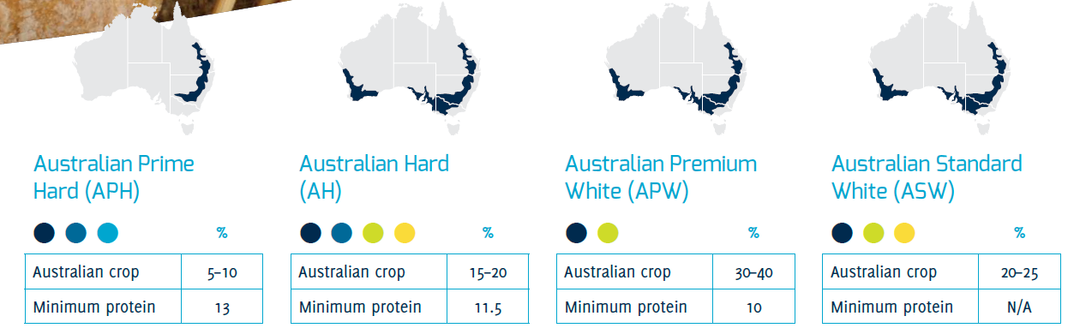
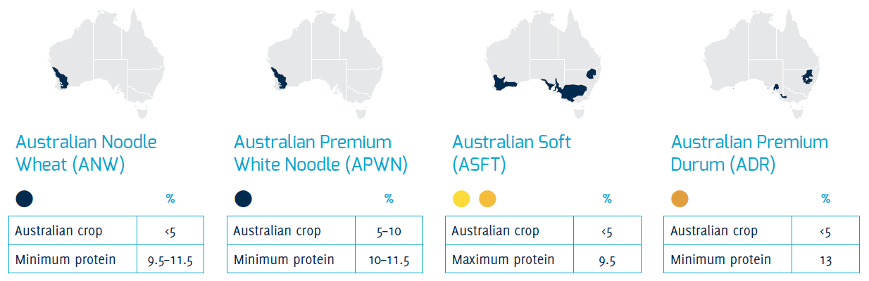
Notes:
2n = 14 i.e. 7 pairs. Polyploid cells and organisms are those containing more than two paired sets of chromosomes. Most species whose cells have nuclei are diploid, meaning they have two sets of chromosomes—one set inherited from each parent. Tetraploids (Durum) have two sets of paired (or 4 sets) chromasomes. Hexaploids have three sets of paired chromosomes (six sets), three times as many as in diploid wheat

Slide 13

Growing Barley – Western Australia
Influencing the yield and quality of barley varieties with good agronomic practices
Acknowledge: Blakely Paynter
Senior Research Officer
Department of Primary Industries and Regional Development

Slide 14
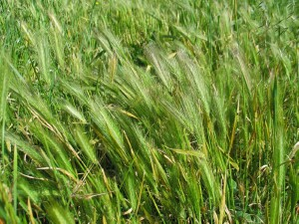
Taxonomy – barley
Domesticated barley (Hordeum vulgare) descended from wild barley (Hordeum spontaneum) - is one of 31 Hordeum species
Barley grass (weed)
(Hordeum leporinum/
Hordeum glaucum)

Slide 15
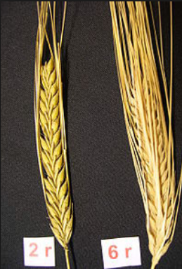
Spike/Spikelet –barley
Two-rowed and six-rowed varieties – both have three florets at each node
Two-rowed barley only the central floret is fertile (most are two rowed)
Six-rowed all florets are fertile

Slide 16
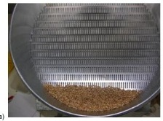
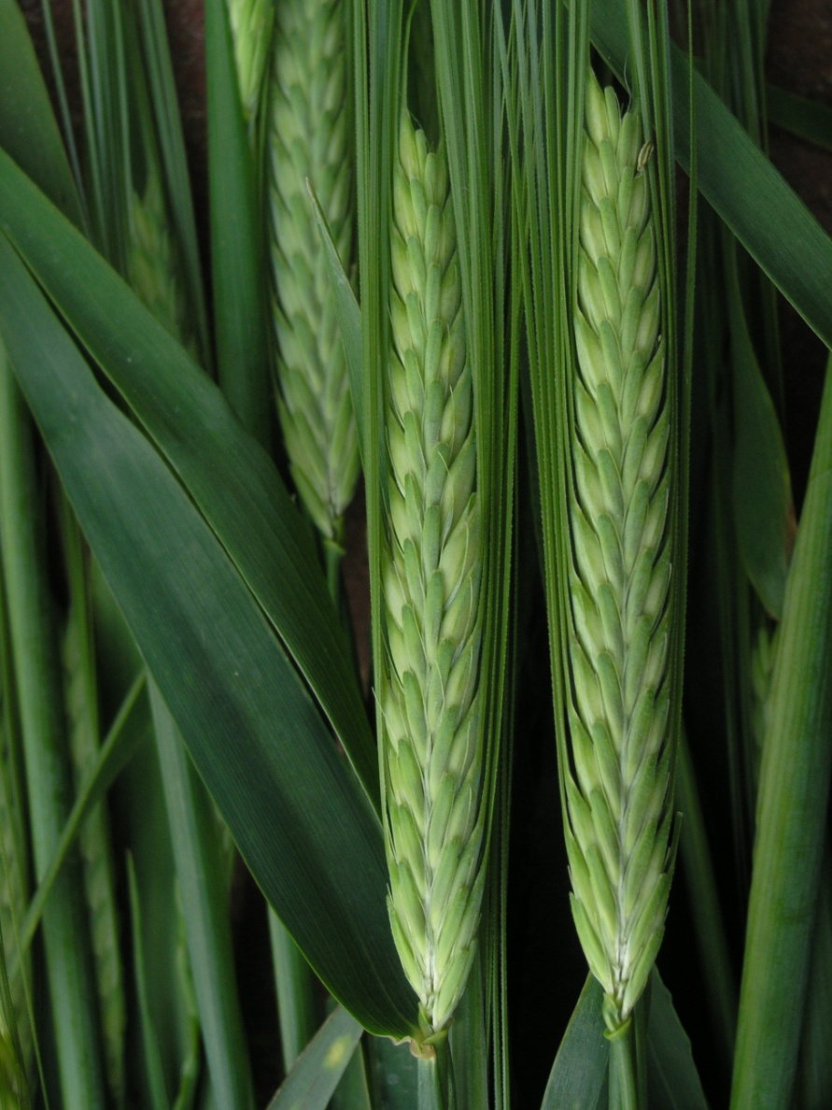
Barley – Malt vs feed
http://www.graintrade.org.au/sites/default/files/file/Commodity%20Standards/2013_2014/Section%2002%20-%20Barley%20Standards%20201314%20Final.pdf
Malt 1,2 – Premium price - only specific accredited varieties (Malt – Purity 95%).
    Max moisture – 12.5%
    Protein – min 9 - 9.5% max 12.8%
    Screenings (2.5 mm screen)
    – Malt 1 = 20%, Malt 2 = 35%
    Test weight 64 (kg/hl)
Feed – Any variety
    Moisture max 12.5%
    Screenings – No limit
    Test weight 56 (kg/hl)

Slide 17

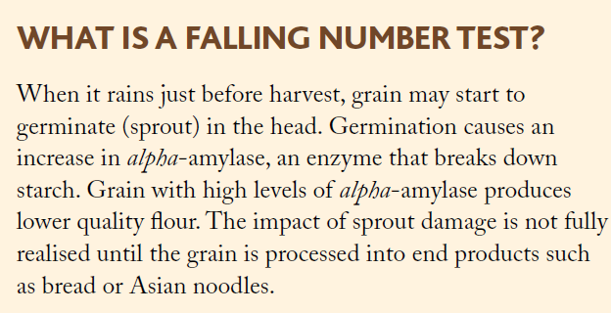
Falling number
The endosperm contains about 65% starch
when heated in water it makes a thick paste and it takes more seconds for a plunger to reach bottom of a container.
With less starch/more sugar – become watery – less time

Slide 18
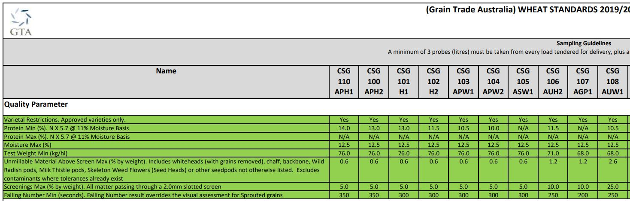
Grain standards

Slide 19
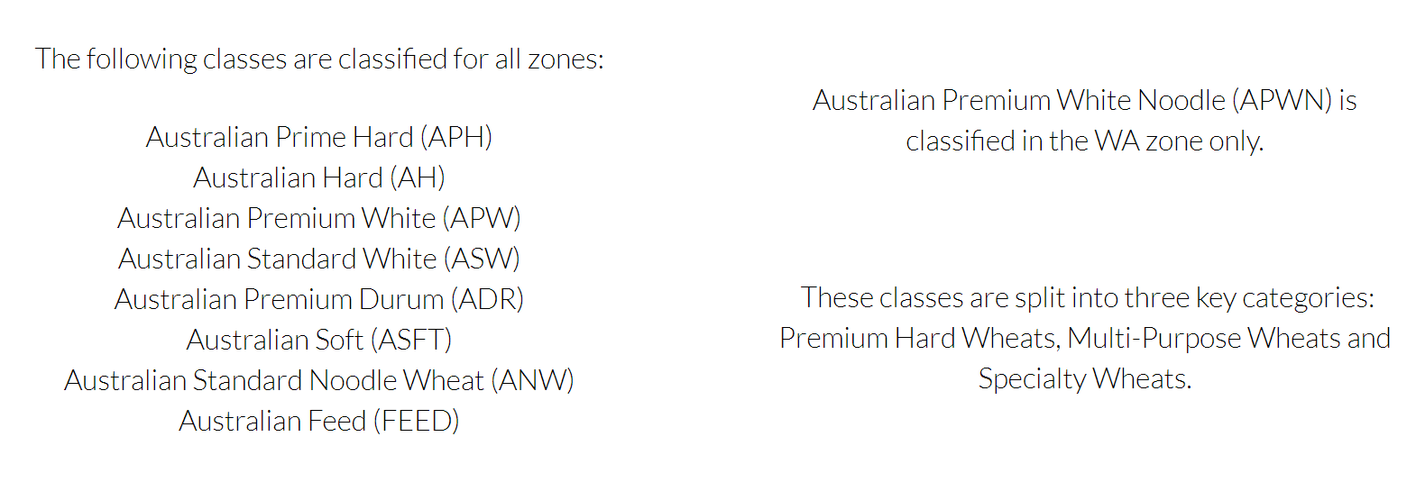
Grain standards
http://www.graintrade.org.au/commodity_standards
Grain Trade Australia, CBH, GrainCorp, Viterra

Slide 20

Grain standards

Slide 21
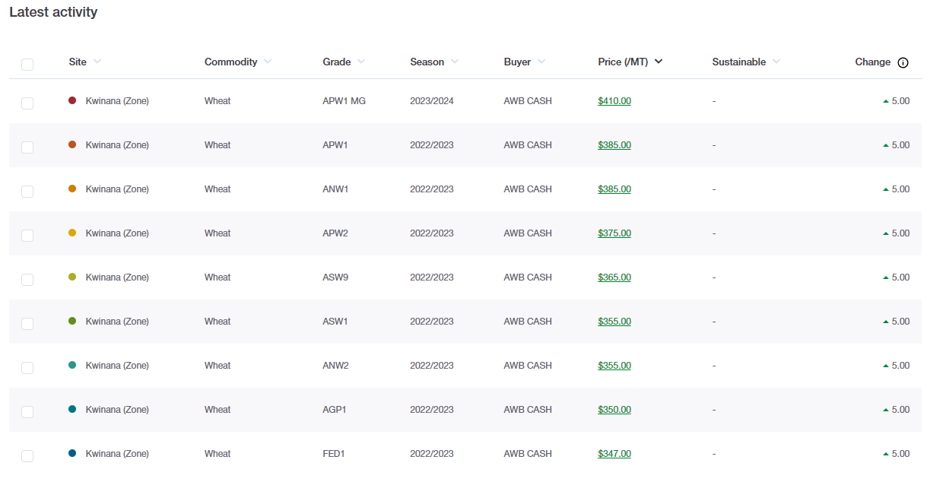

Slide 22
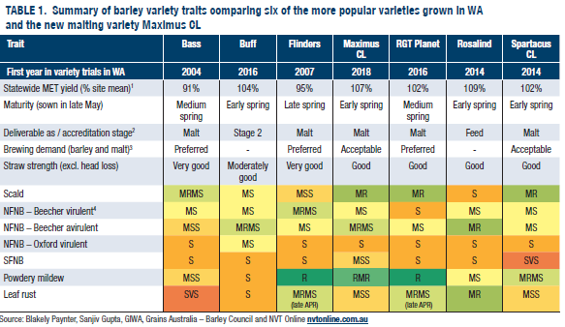

Slide 23
Barley – agronomy topics
The decision whether to grow barley for the malting or feed grade depends on four main factors:
the premium paid for malt barley;
the relative yields of malting and feed grade barley;
agronomic and disease constraints of the different varieties; and
the likelihood that grain of a malting barley variety will be acceptable for inclusion into the malting grade.

Slide 24

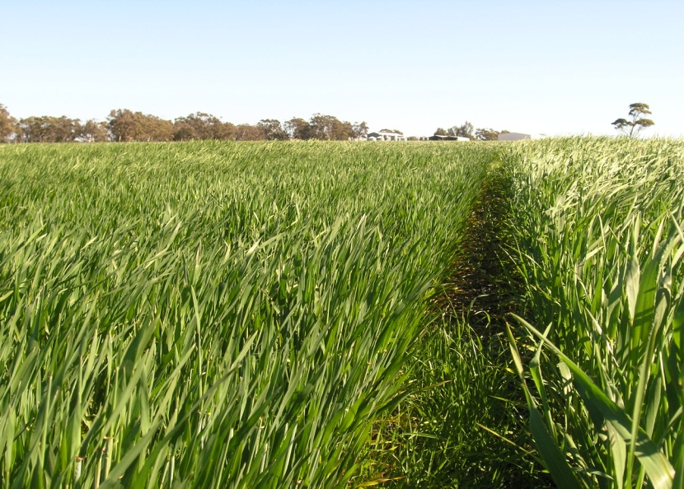
Barley – season type
Winter barleys require a period of cold (vernalisation) to initiate reproduction
9 – 10 month season vs spring 6 – 7 months
Breeding aim – spring barley
Winter barley
Spring barley

Slide 25
Barley – agronomy topics
Production
Grain protein
Screenings
Grain brightness
Management principles

Slide 26
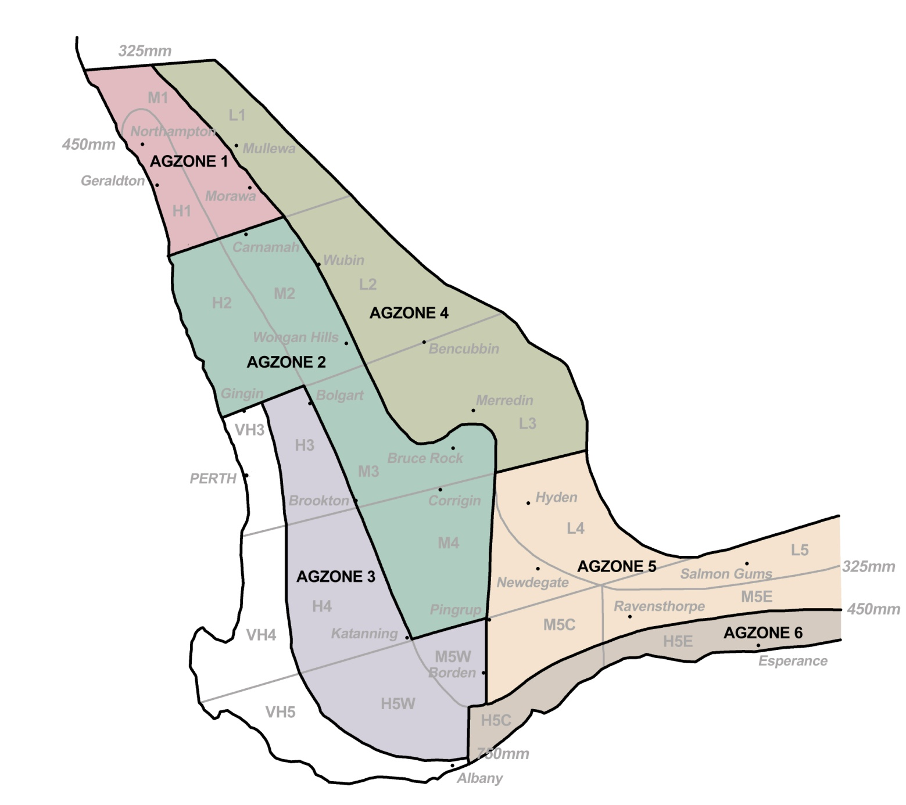
Barley – where?
170,000 ha
40,000 ha
360,000 ha
160,000 ha
200,000 ha
160,000 ha

Slide 27
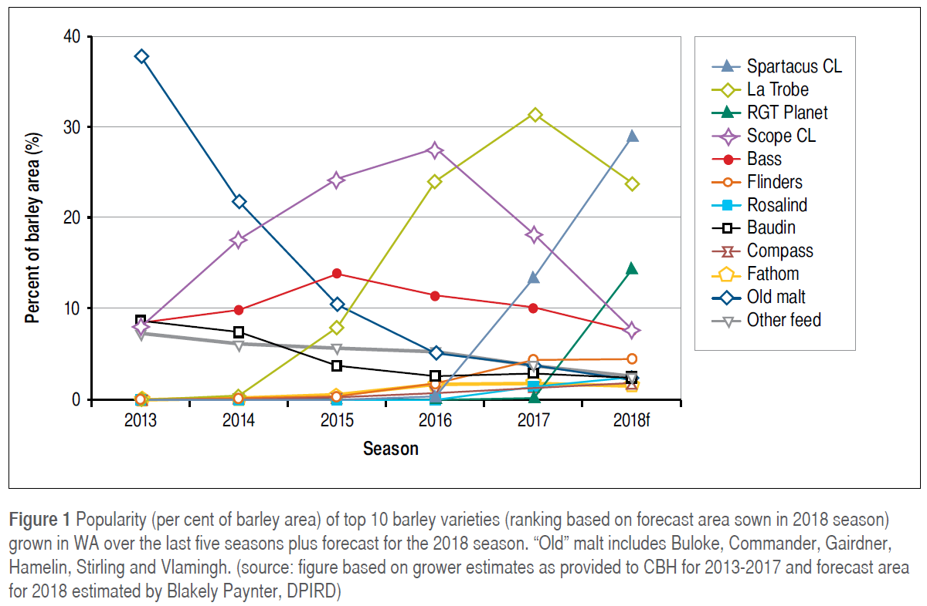
Barley – which varieties?
42%
18%
8%
2019

Slide 28
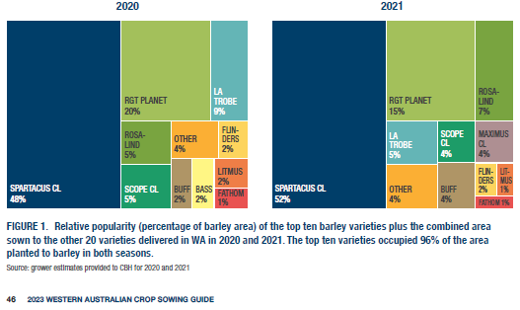

Slide 29

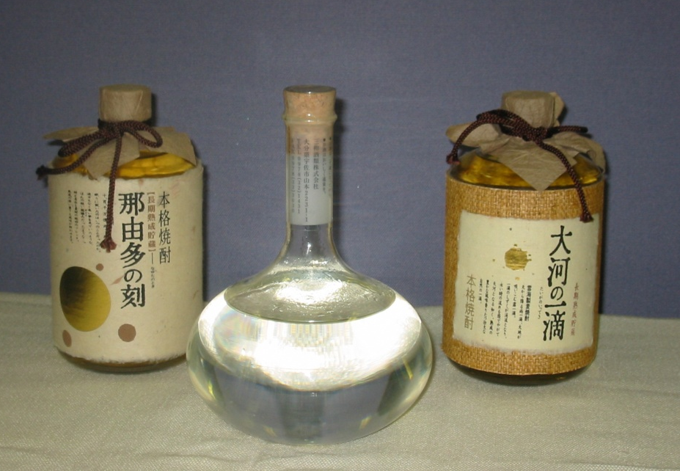
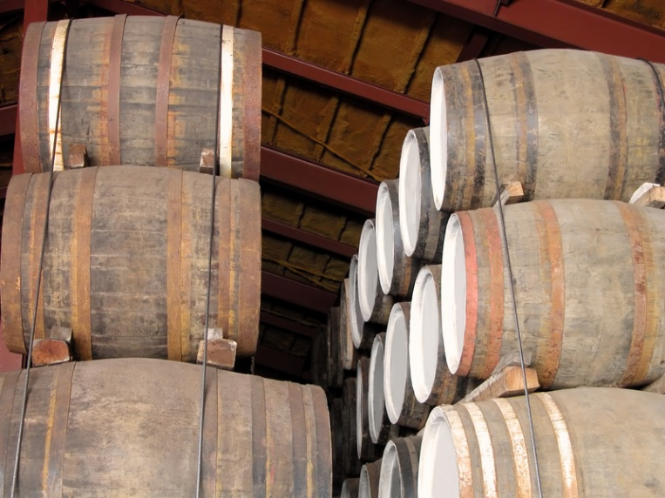
End Uses – malt barley
Shochu, whiskey and other distilled spirit
The number #1 quality focus for the WA barley market is for beer production

Slide 30
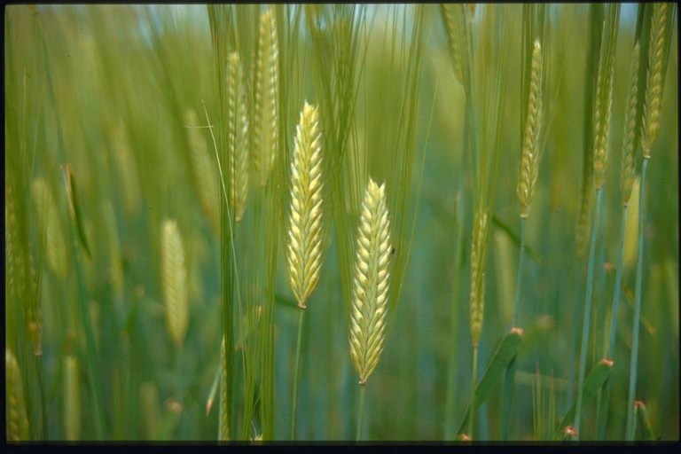
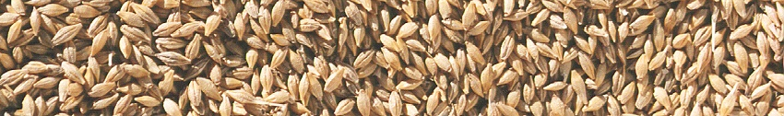
Grain Quality Issues – malt barley
Seven grain quality parameters:
Germination
Variety purity
Hectolitre (100 L) weight
Grain protein
Screenings
Grain colour
Skinning (outer husk lost- uneven malting/germ)

Slide 31
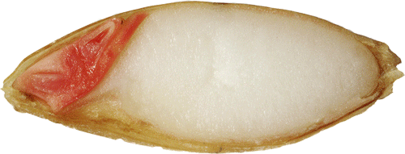
Best Practices – malt barley
Growing “good” malting barley is about:
Genotype/Variety – Baudin, Buloke, Bass, Flinders, Maximus CL, Spartacus
Environment – rainfall, temperature, humidity
Management – soil type, rotation, date of seeding, fertiliser, seeding rate, disease control, insect control, harvest date

Slide 32
Pattern of N uptake – wheat and barley
The pattern of uptake during the growing season
Pattern of N uptake will reflect the changes in growth rates during the growing season.
Essentially a cereal crop goes through two stages
    uptake of N, which drives growth and yield potential,
    and remobilisation of N to the grain, which influences grain protein.
May-sown wheat crop 20-30% of the total N may be taken up by the crop by the start of stem elongation.
The greatest demand for N is stem elongation - when the leaf area is expanding rapidly and the crop is growing most rapidly.
  build the yield potential of the crop
  N reserves for grain protein as most of the N present in the grain is derived from N remobilised from the leaves and other green tissues during grain filling.
https://grdc.com.au/Research-and-Development/GRDC-Update-Papers/2013/02/Nitrogen-decision-Guidelines-and-rules-of-thumb

Slide 33
Spike/Spikelet – wheat and barley
The pattern of uptake during the growing season …
By flowering, about 80-90% of the total crop N has accumulated.
Crops can still take up N during grain filling if there is sufficient soil moisture, the roots are active and N is present in the soil. This will tend to maintain green leaf area during grain filling and reduce the amount of N remobilised to the grain early in grain filling. These conditions favour starch production in the grain and can lead to low grain protein concentrations.
At maturity > about 75% of the total N taken up by the shoots during the year has been mobilised to the grain, although this can range from 60% to up to 80%.
Under high rates of N the proportion remobilised to the grain tends to be lower compared to low rates of N.

Slide 34
Grain Protein – importance
Measures proportion of protein in grain
Target – 9.5% to 12.8%
One of the most important grain traits

Slide 35

Grain Protein – importance
Consequence of high protein (> 12.8%)
  decreases alcohol production per t grain
  increases filtration times in brewery
  increase potential for beer haze
  decreases shelf life of beer
Consequence of low protein (< 9.5%)
  reduces duration of beer head
  reduces cling of beer to glass
  affects fermentation by not providing enough food for yeast to make alcohol

Slide 36
Grain Protein – agronomy
Factors affecting grain protein include:

Slide 37
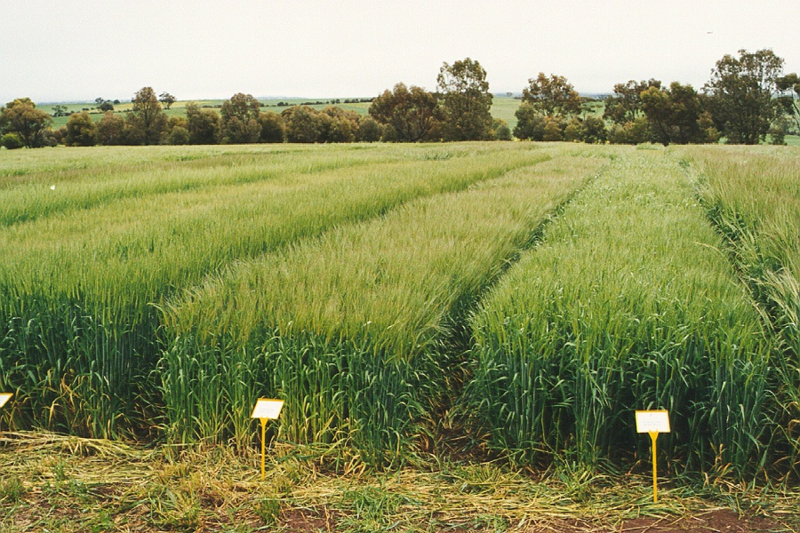
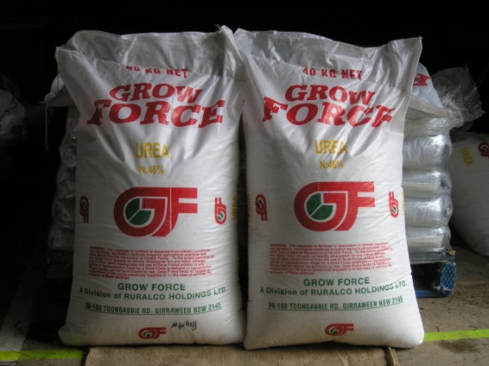
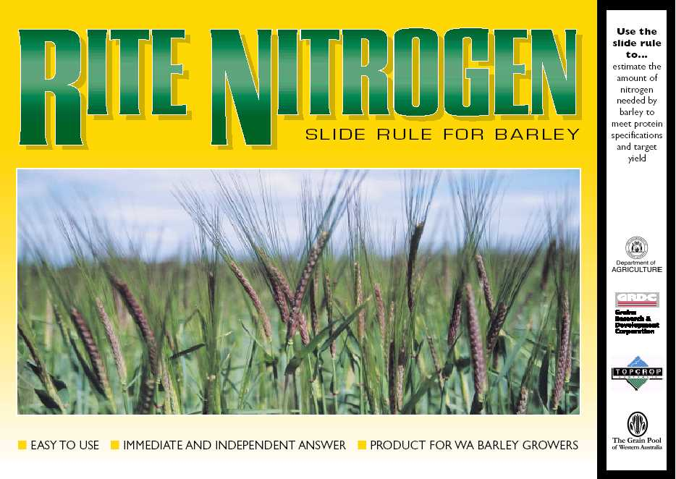
Grain Protein – agronomy
Factors affecting grain protein include:
Crop rotation
Soil type
Soil fertility
Fertiliser applied nitrogen
Variety (yield potential, N harvest index)
Conditions during grain filling

Slide 38
Grain Protein – calculating soil N
Organic Matter
Non
Legume

Slide 39
Grain Protein – N supply and yield

Slide 40
Grain Protein – agronomy
Factors affecting grain protein include:
Crop rotation
Soil type
Soil fertility
Fertiliser applied nitrogen
Variety (yield potential, N harvest index)
Conditions during grain filling

Slide 41
Grain Protein – rate and timing
Timing impact generally smaller than rate

Slide 42
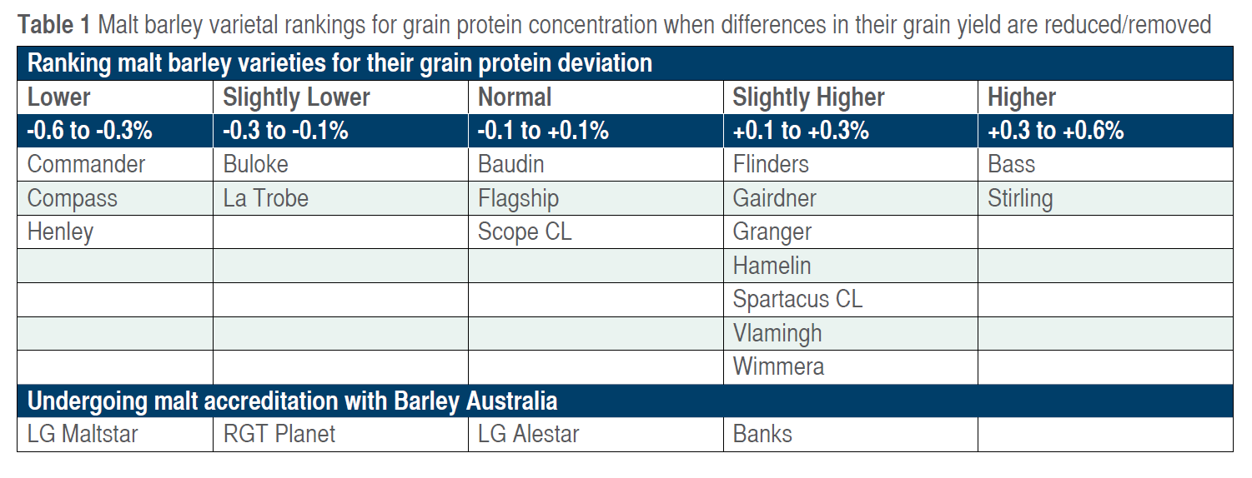
Variety differences for grain protein

Slide 43
Grain Protein – management
Site and rate of N fertiliser are primary determinants of grain protein in barley
Impact of variety and split applications of N are secondary
Soil test to determine organic carbon
Choose a non-legume rotation
Use of tools such as Yield Prophet can estimate the N rate needed to reach 10 to 11% protein

Slide 44
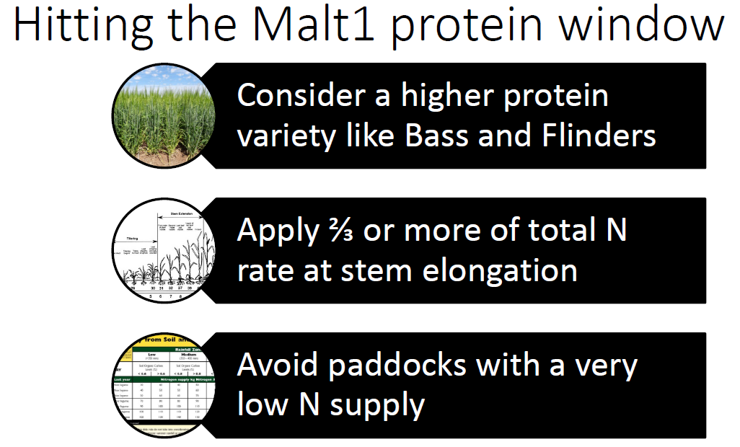
Management

Slide 45
To increase grain protein
Apply higher levels of N
Additional N at flag leaf emergence can boost grain protein

Slide 46
Screenings – importance
Measure of grain plumpness (grain width)
Target - <10% through 2.2mm (Malt 1 7%)
Correlated with grain weight (starch %)
5% screenings in wheat

Slide 47
Screenings – importance
Grain plumpness determines
  amount of grain available to be malted
  time for grains to soak up enough water
  duration of malting process
Difference between 10% and 20% screenings
is 3% less maltable grain

Slide 48
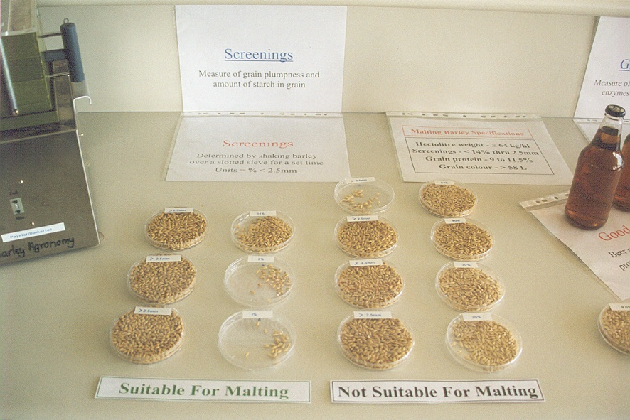
Screenings – agronomy
Factors affecting screenings include:
Crop rotation
Soil type
Soil fertility
Applied nitrogen
Disease
Variety (grain shape)
Environmental conditions during grain filling

Slide 49
Screenings – grain shape
Grain shape influences how a variety responds to management

Slide 50
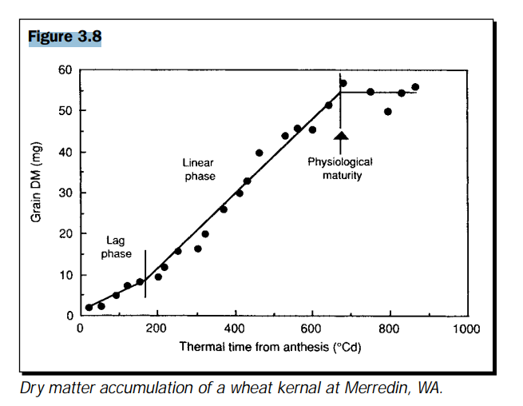
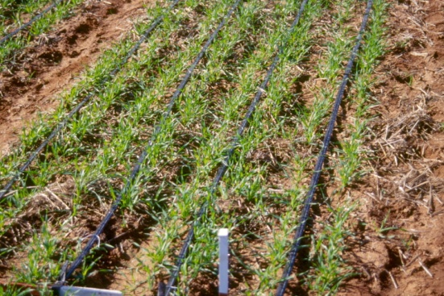
Screenings – rainfall during grain fill

Slide 51
Screenings – nitrogen application
Average rainfall during spring
Below average rainfall during spring
20%

Slide 52
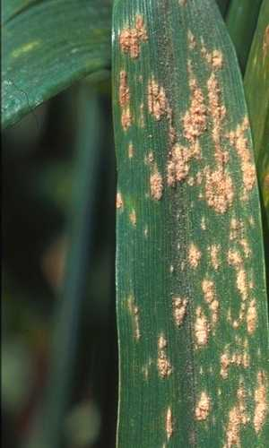
Screenings – disease
Powdery mildew dominant disease
Grain yield
Grain quality
5.00
50
4.00
40
3.00
30
Yield (t/ha)
Screenings (% < 2.5mm)
2.00
20
1.00
10
0.00
0
MR/MS
S
MR/MS
S
Baytan only
Baytan + fungicide spray
Source: Kith Jayasena and Geoff Thomas, DAFWA

Slide 53
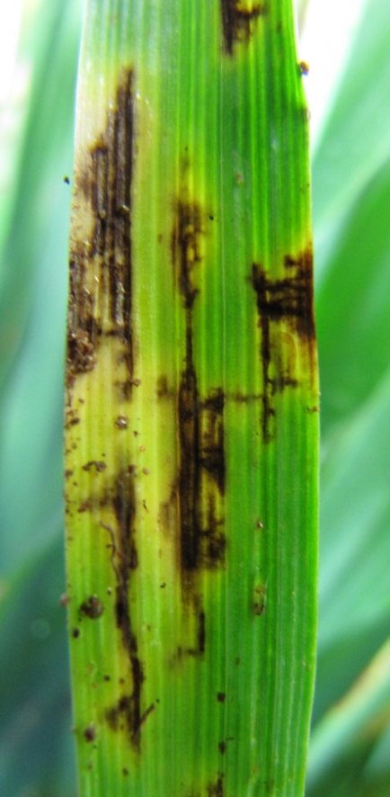
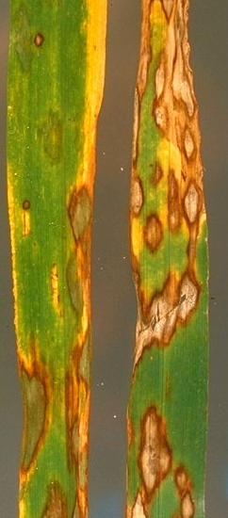
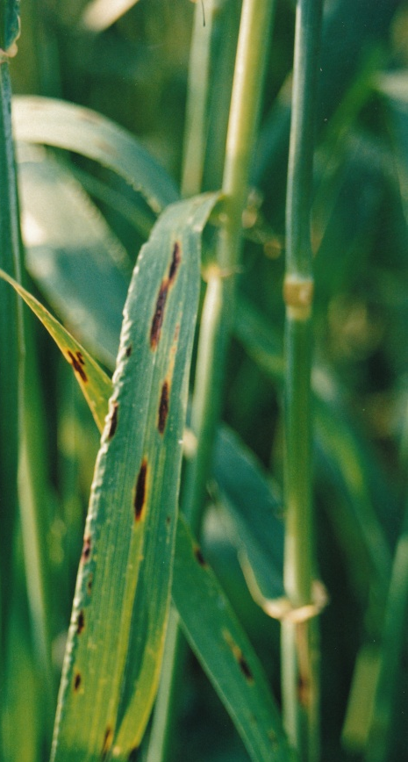
Barley – disease resistance
Net type net blotch Scald
Powdery mildew Spot type net blotch
Aim: build disease resistance into elite genetic backgrounds

Slide 54
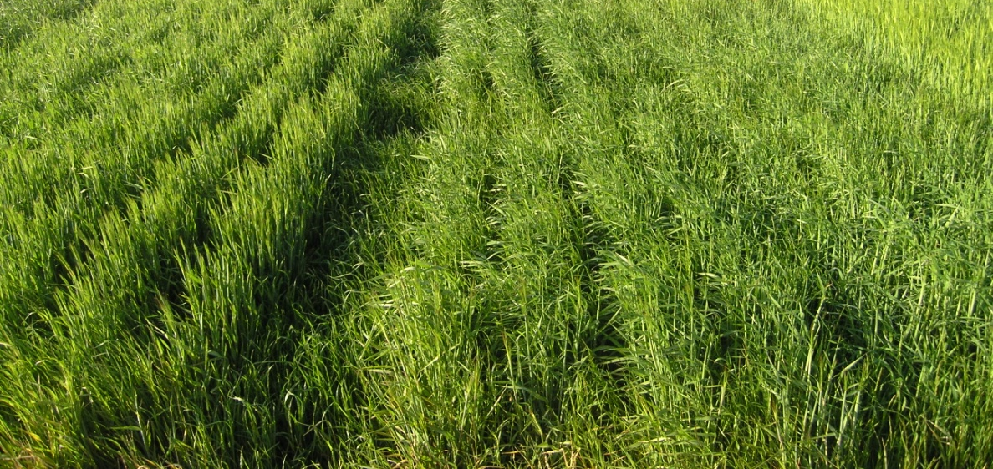
Screenings – seed rate & weeds
120-150 plants/m2 recommended

Slide 55
Screenings – management
Choose variety, then choose management
Management choices:
  soil type (critical for malting barley)
  time of sowing (early usually better)
  N fertiliser (match yield potential with supply)
  seeding rate (only an issue with late sowing)
  weeds (rotation and herbicides)
  disease control (rotation and fungicides)
  insect control (grain fill a critical period)

Slide 56
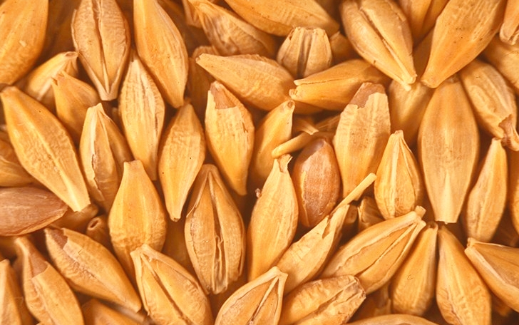
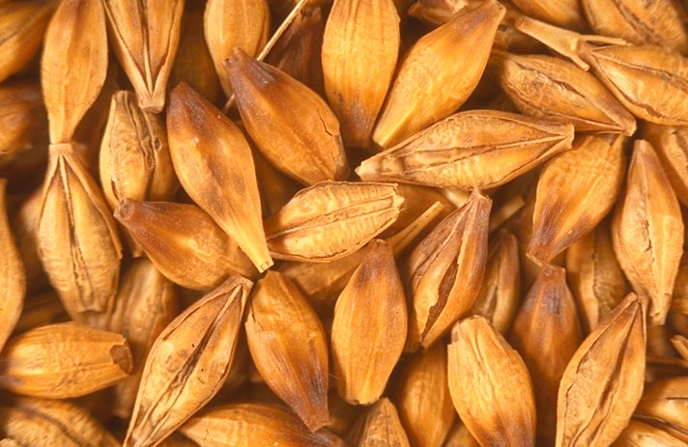
Grain Brightness – yellowing
Discolouration due to light showers or high 3-PM RH causes yellowing
No fungi are involved
Measured by determining grain brightness
Target - >59 L (lux) (Minolta colour meter)

Slide 57
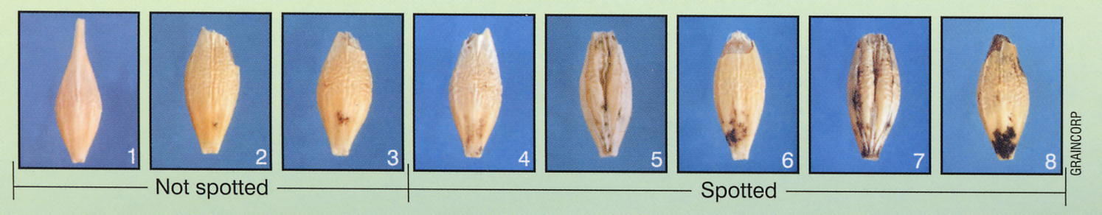
Grain Brightness – greying
Discolouration of the grain due to heavy showers causes greying
Associated with moulds and fungi
Measured by counting affected per 400 grains
Target - < 5% mould affected

Slide 58
Grain Brightness – importance
Grain discolouration
  has little effect on malting process
  grain less suited to pale coloured beer market
  may indicate presence of fungi and mould
Presence of mould and fungi may
  induce dormancy and increase storage time
  increase sensitivity of grain to water in steep
  decrease alcohol yield
  cause gushing (excess foaming) in the brewery

Slide 59

Grain Brightness – agronomy
Factors affecting grain colour are:
Variety (grain brightness)
Date of seeding
Relative humidity at 3-PM
Rainfall during crop maturity and harvest

Slide 60
Grain Brightness – location

Slide 61
Grain Brightness – management
Grain brightness is controlled by relative humidity, so being close to the coast is a disadvantage
Best agronomic practices can result in a minor improvement in brightness
Best solution to improve grain brightness is to use brighter varieties

Slide 62
Summary – agronomic principles
Producing premium grade, malting barley:
Rotation – non-legume rotation best
Soil type – those that hold moisture for spring
Time of Sowing – early as possible for the variety
Applied N – match to protein and yield target
Seeding Rate – 120 to 150 plants/m²
Disease – seed dress and monitor foliar disease
Aphids – control aphid feeding during grain fill
Weeds – take out early and use IWM

Slide 63
Summary – agronomic principles
The interaction is often very important

Slide 64


Cheers
This research is supported by DAFWA and the GRDC (DAW00148 and DAW00149)

Slide 65

Screenings – row spacing & weeds

